Slide 1

WINERY DATA

Slide 2
World of Wine
01.
03.
02.
04.
Winery Dataset Overview
RFM Analysis
Data Overview & Question
More granular segmentation
Customer Segmentation Analysis
Recommendations
Looking at provided segments and how to target them
Identify opportunity area to improve

Slide 3


Data Overview
$20B winery industry
Customer-level purchase data for a winery over 2 years (July 2008— Jun 2010)
Customer ID, Order ID, Customer Segment, Date, Zip code, State, Sales 2008-2010, Sales Amount, Year Acquired, Sales from Tasting Room/Email/Newsletter/Winemaker Call
Already established four customer segments:
Casual Visitor
Luxury Estate
High Roller
Wine Enthusiast

Slide 4

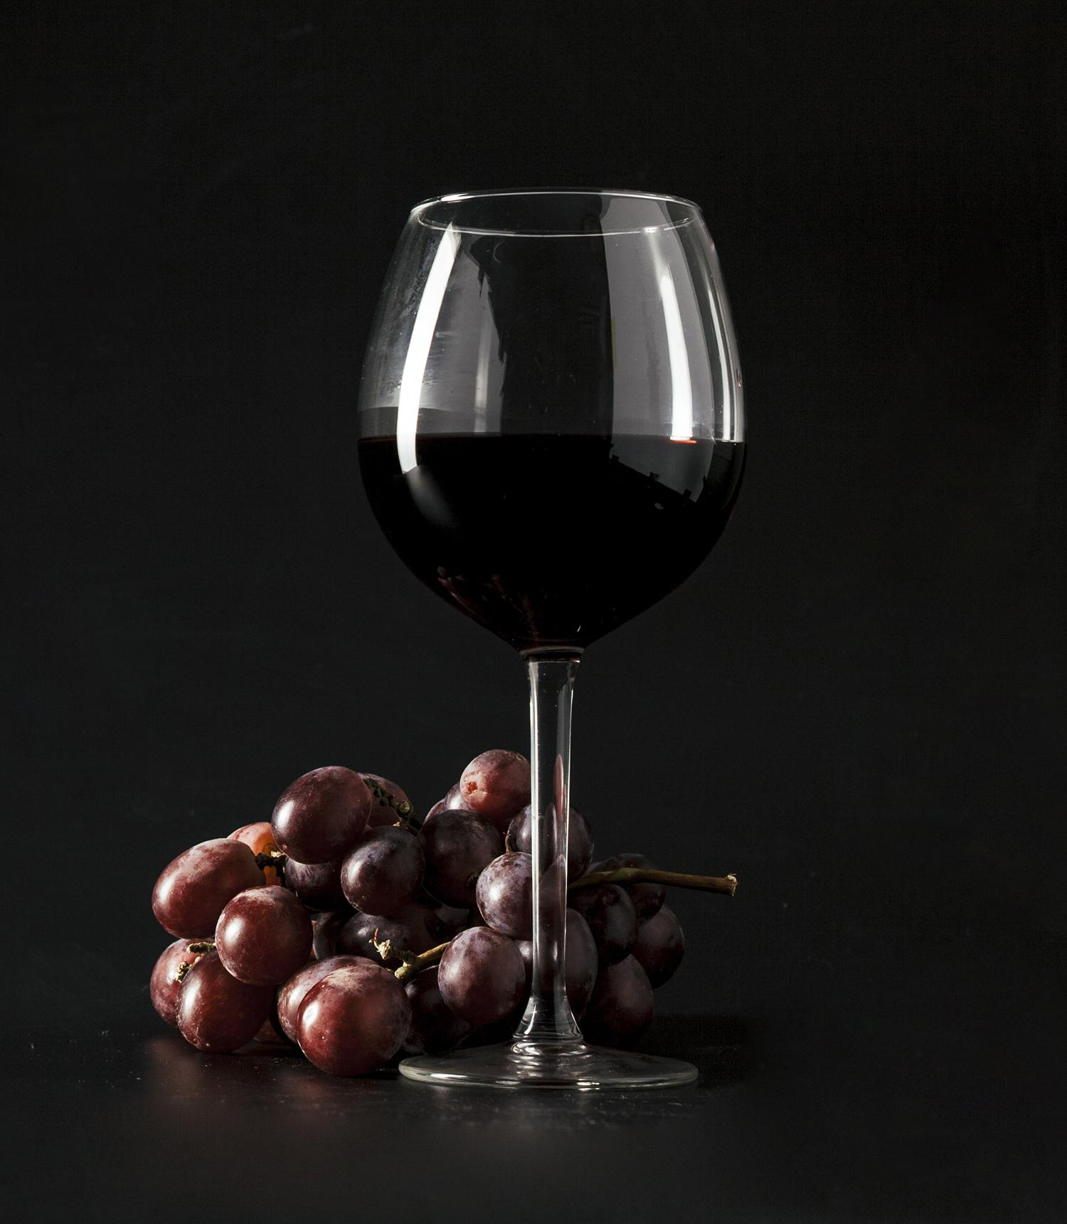

WINE SEGMENTS
Casual Visitor
Luxury Estate
Typically, tourists on afternoon outings to relax and socialize, often as part of a tour group
“Bluebloods” who prefer to be low-key, but appreciate the finer things in life
Wine Enthusiast
High Roller
A diverse group who loves wine, but are also willing to take the time to wait and collect at a good price
Higher income professionals who like to “see and be seen” and enjoy being treated as a “special guest”

Slide 5
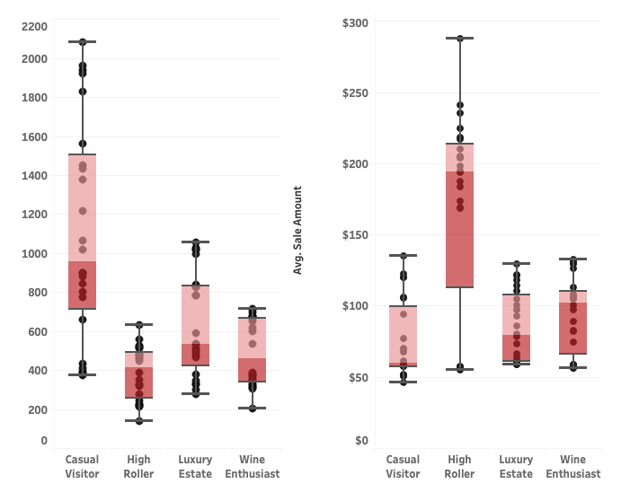
Customer Segment Insights
No . of Customers
Monthly Average sales
Average spending of High Rollers each month is far greater than any of the other three segments.
On an individual basis, the typical High Roller is predicted to be the winery’s most valuable customer.
Casual Visitor represents most of the customers, but they only have the third highest sales. This is the segment that has the largest potential sales to the winery.

Slide 6
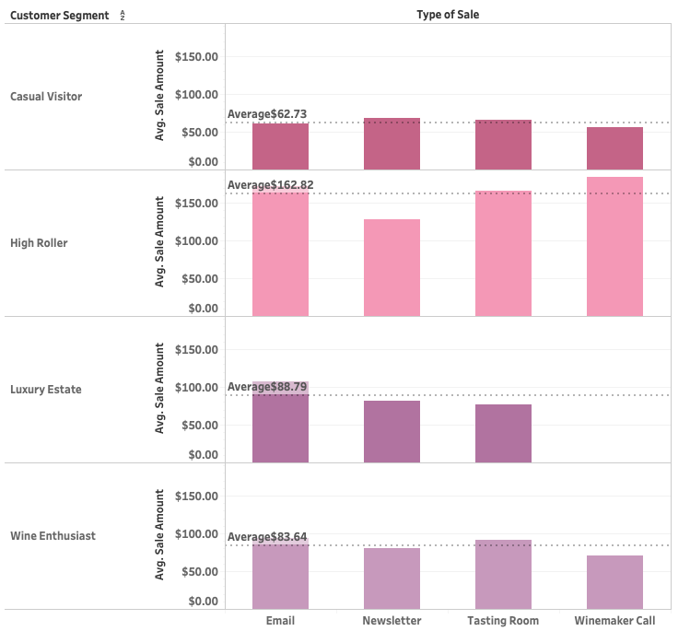
Most Popular Sales Channel – Segment Wise
Overall Average Spending
$ 88.5
Lowest Average Spending
Most Active in the Tasting Room
Highest Overall Average Spending
Biggest Spender in the Tasting Room
Responsive to Winemaker Calls
Second Highest Average Spending
Responsive to Email
Not Responsive to Winemaker Calls
Similar buying behavior across channels, Loyal Wine lovers
Notes:
Tasting room:
often first sample/buy wine
sign up for newsletters/emails
join the wine club

Slide 7
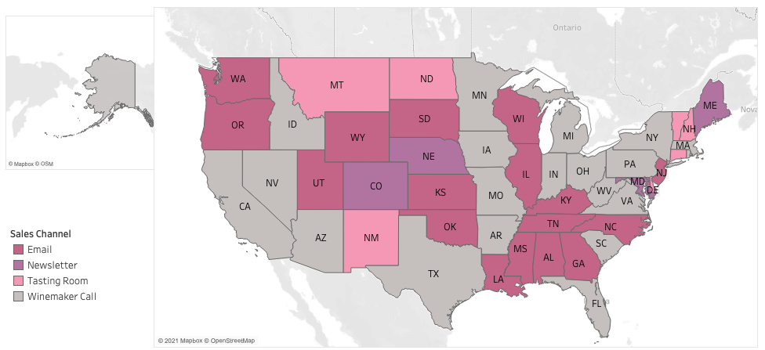
Most Popular Sales Channel Across US
Channel highlighted with the highest average sales in that state

Slide 8

Question
How do you target each segment from their behaviors?
Notes:
After having a good overview of the dataset, we decided to dive deep into their initial 4 segments of customers and evaluate the effectiveness of each channel for targeting different audience.

Slide 9
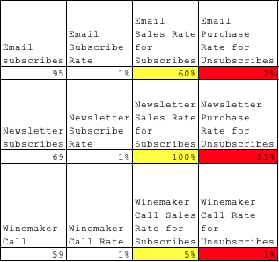
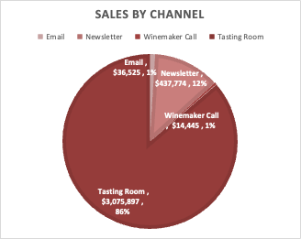
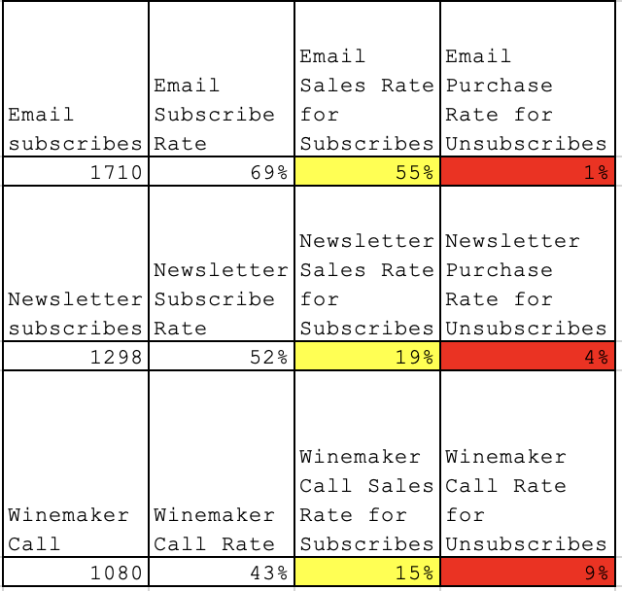
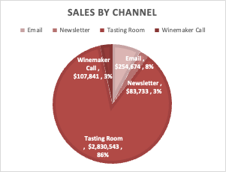
Casual Visitor – 30% of total sales
86% of the sales for this segment are from the Tasting Room
Low subscription rate for all channels
Purchase rate of email subscribers and newsletter subscribers are much higher than non – subscribers
All newsletter subscribers in this segment end up with a newsletter sales.
High Roller– 28% of total sales
86% of the sales for this segment are from the Tasting Room
Good subscription rate for all channels
Purchase rate of email subscribers are much higher than non – subscribers
Winemaker Call is not effective as other segments
Notes:
In this slide, we will first look in to the casual visitor segment. This is an important segment because almost half of the customers were classified as casual visitors and 30% of the winery sales came from this segment.
From the pie chart on the upper left, we can conclude that most of the sales actually came from tasting rooms. However, given the limitation of the dataset we have, we will focus on evaluating the performance of the other three marketing channels – emails, newsletters and winemaker calls for all four segments.
From the table in the middle, we can see that only 1% casual visitors subscribes to emails or newsletters or picking up winemaker calls. However, by comparing the response rate of subscribers and non-subscribers, we can see there is a huge difference. We even found 100% of newsletter subscribers made a purchase while only 21% of non-subscribers made a purchase through newsletter. Therefore, we will recommend the business owner to put more efforts into driving more subscriptions for email and newsletter. Winemaker calls are not recommended for this segment considering the low response rate .
High Roller is another important segment – 28% of total sales came from this segment. A lot more people in this segment subscribed to the those channels and engage with the winery store. By comparing the response rate, email is the most effective channel for this segment. Considering the high subscription rate, customer retening strategies should be developed for this segment across those channels. Winemaker calls are more attractive to this segment compared to others.

Slide 10
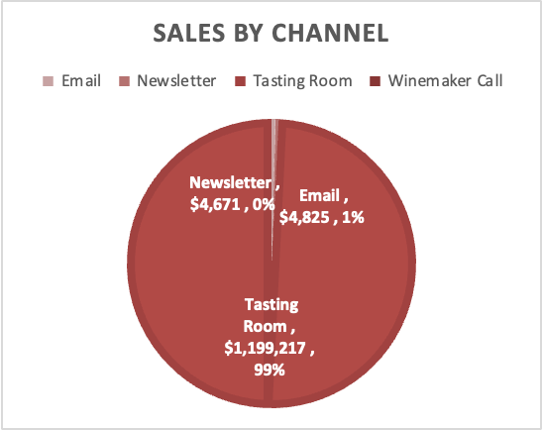
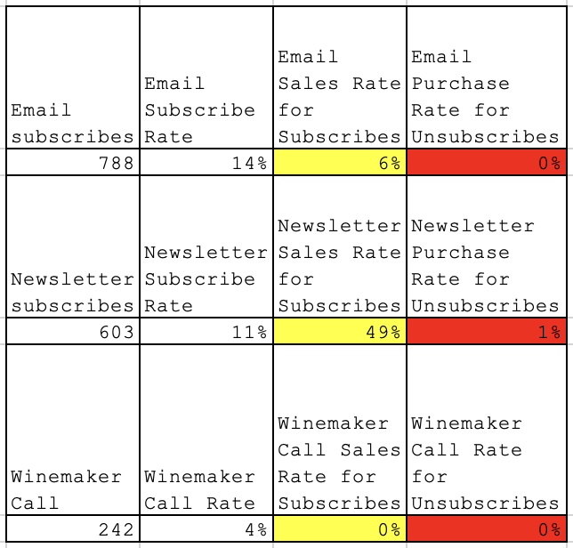
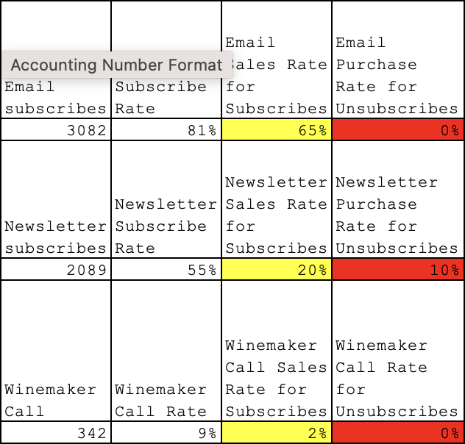
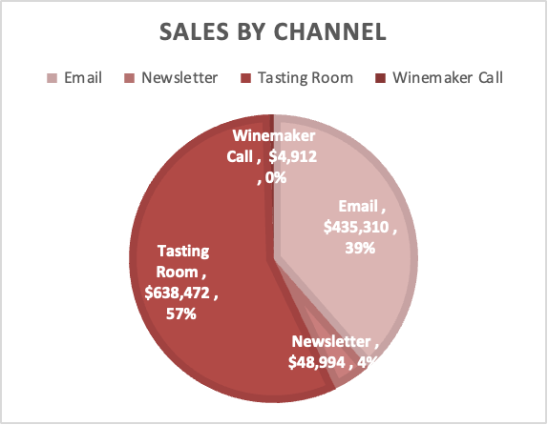
Luxury Estate– 21% of total sales
99% of sales for this segment are from Tasting Room
Low subscription rate to emails, newsletters
Newsletter subscribers have a good response rate
Zero response rate for wine maker calls
Wine Enthusiast– 20% of total sales
57% of the sales for this segment are from the Tasting Room, 39% from Emails
69% of casual visitors subscribed to Emails
Very high subscription rate for emails
Good subscription rate for newsletters but response rate is only 20%
Winemaker calls do not work for this segment
Notes:
The other two segments are luxury estate and wine enthusiast. 21% of sales came from this segment. A huge difference about this segment is that 99% of sales came from tasting rooms. So emails are bit attactive enough for this segment. Newsletters have a low subscription rate but good response rate – so it is a good idea to develop newsletters for this channel. for winerycalls, zero luxury estate customers were converted there.
Wine enthusiasts have a very high email and newsletter subscription rate, and more likely to purchase through emails and newsletters. Therefore, we will recommend keeping up the good contents in emails and at the same time put more effort into newsletters for this segment.

Slide 11
Question
Is there a better way to segment the customers to get more insights?

Slide 12
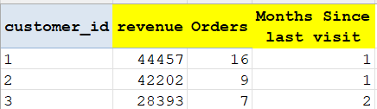
RFM Analysis
Reasons for taking the RFM Approach
RFM scores are easy to calculate
It is based on customer behavior and not demographics
This data-set contains all the data we need to run an RFM analysis
Methodology
Data was transformed into a new set of data that displayed each customer’s most recent wine purchase (Recency); total transactions over the years (Frequency); and total sales amount per customer (Monetary value).

Slide 13
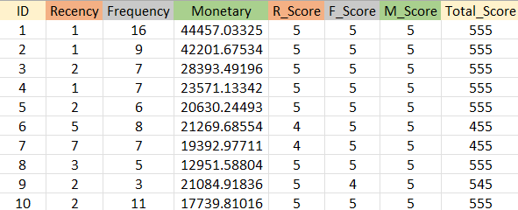
RFM Analysis
Customers were scored by quintiles with a rank of “5” being “the best” and “1” being the worst.
The table on the left shows the RFM scores for the first 10 customers
After calculating the score for each customers, customers with the same total score are part of the same segment. Now the winery can choose a sample of these customers and recommend a product to see how each segment responds to that product to calculate a response rate.
Notes:
So we did the analysis on R and got scores for each customer
We got the recency score, the frequency score and the monetary score and a total score which is a combination of these 3.
The table on the graph shows the score for the first 10 customers.
The customers were scored by quintiles with 5 being the best and 1 being the worst
Last para of this slide

Slide 14
RFM Analysis
Since we can’t recommend anything to these customers, we decided to use these RFM scores to see how these segments react to the different sales channels through which wine is sold.
Our dataset contains data from 4 channels:
Tasting Room (No subscription Required)
Email Sales (Subscription Required)
Newsletter Sales (Subscription Required)
Winemaker Calls (Subscription Required)
We decided to focus our analysis on the channels that require a subscription only.
Why?
Notes:
Ill get to they why, first let me explain what we did.
So for our analysis we decided to calculate a subscriber rate and a buyer rate.
Subscriber rate is how many people from that particular segment subscribe to that channel
And buyer rate is how many people from that segment actually buy through that channel.
Through these two rates we also calculated a buyer to subscriber ratio that tells us what percentage of the subscriber are actually buying.

Slide 15
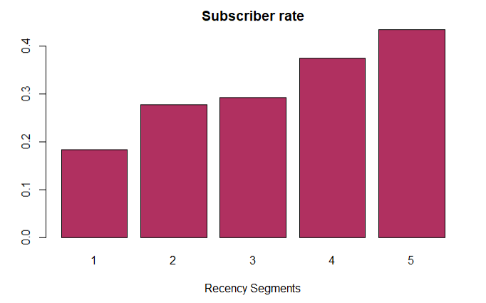
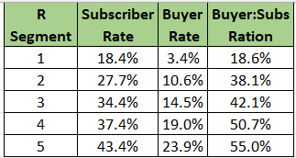
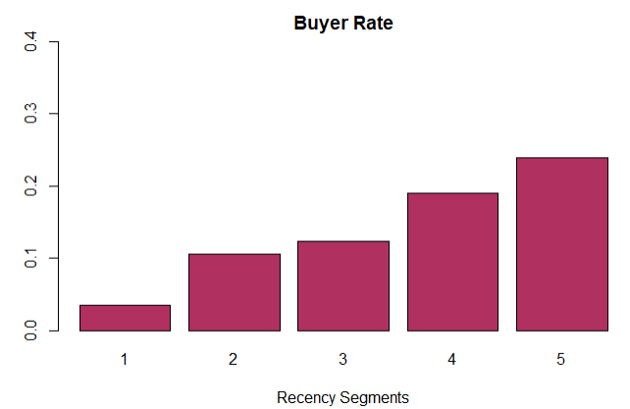
RFM: Email Subscribers Recency
Notes:
Now we will first go through the email channel.
Here are the recency segments for the email channel. As you can see all the rates increase as we go from segment 1 which is the worst segment to 5 which is the best segment.

Slide 16
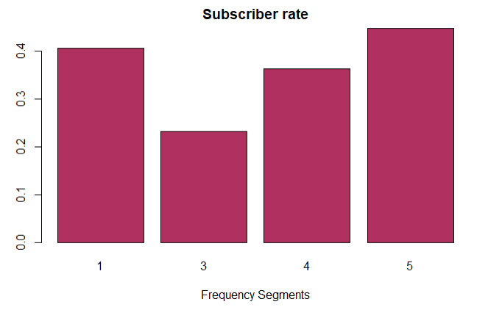
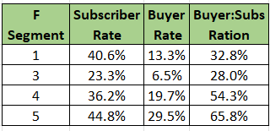
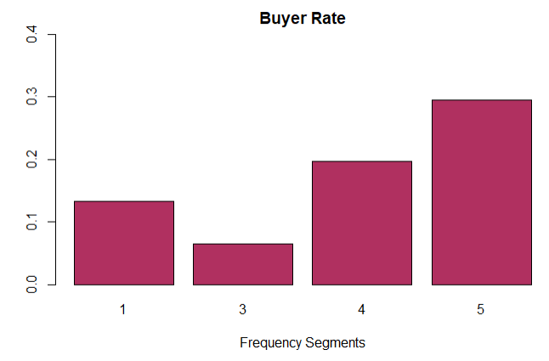
RFM: Email Subscribers Frequency
Notes:
However for the other analysis we took two types of response variables
1. Whether or not a customer has subscribed to the email channel and also if they buy through that channel after subscribing.

Slide 17
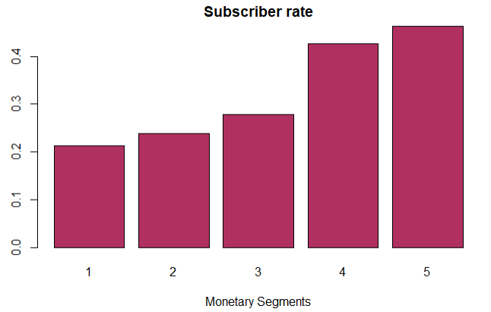
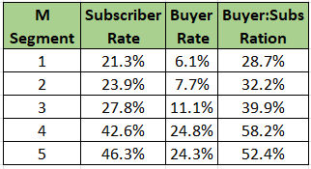
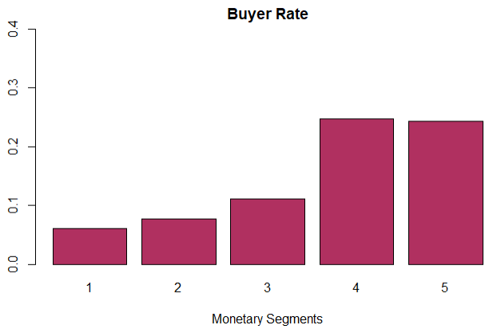
RFM: Email Subscribers Monetary
Notes:
However for the other analysis we took two types of response variables
1. Whether or not a customer has subscribed to the email channel and also if they buy through that channel after subscribing.

Slide 18
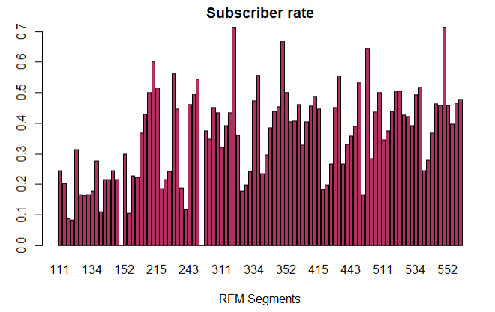
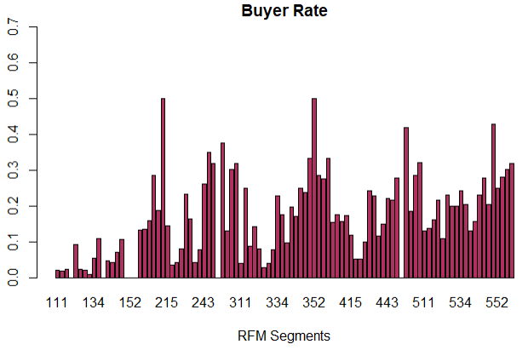
RFM: Email Subscribers

Slide 19
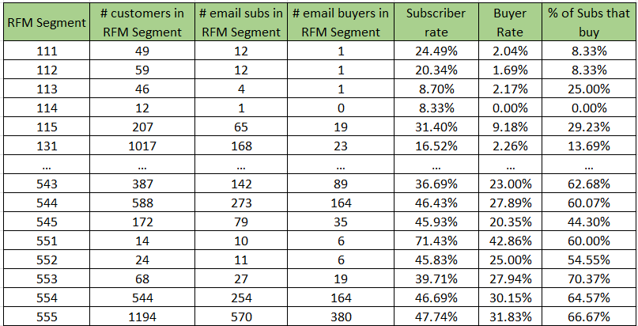
RFM: Email Subscribers
Notes:
This is a summary table that shows the number of people in each segment as well as the subscriber rate, buyer rate and ratio for the email channel. The firm can use this to make marketing decision and decide which segments to target for what type of campaign.

Slide 20
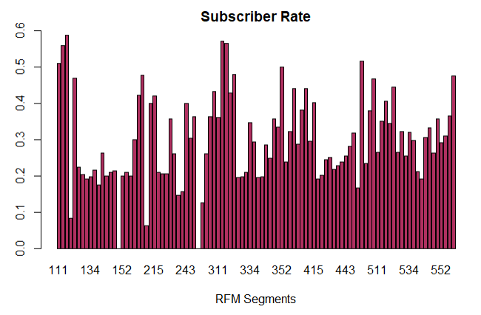
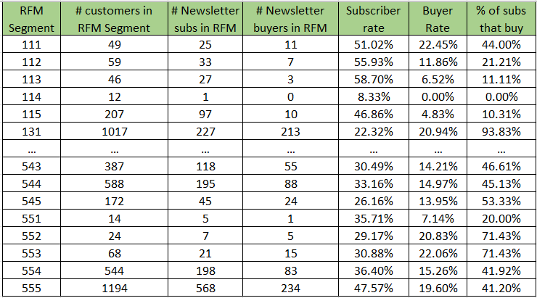
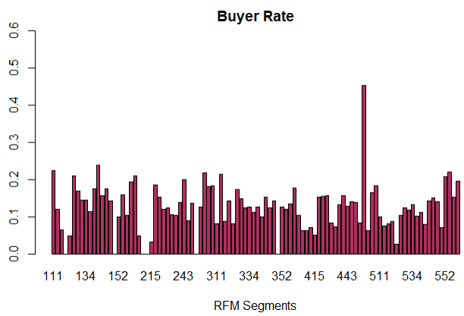
RFM: Newsletter Subscribers
Notes:
What we can see here is that the buyer rate is kind of constant but the buyer:subscriber ratio differs and hence the firm could cut costs by sending the newsletter to only those subscribers that are above the breakeven ratio or maybe send coupons to the segments that are not buying too much to encourage them to buy more.

Slide 21
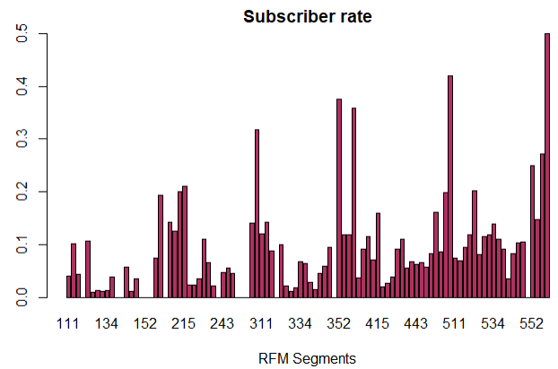
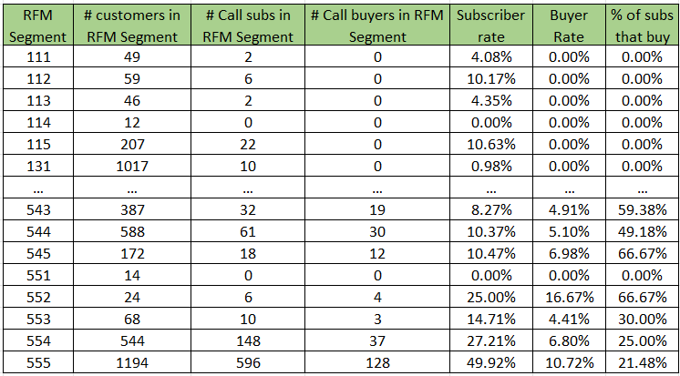
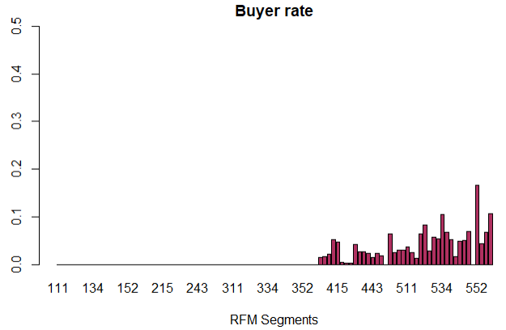
RFM: Winemaker Call Subscribers
Notes:
Similarly we got this for the calls channel. This clearly shows that this is the weakest channel and that the firm should only offer this subscription to segments with a higher RFM score since they are the only ones that buy through this channel

Slide 22
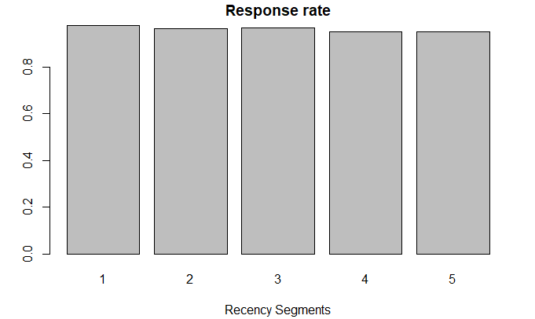
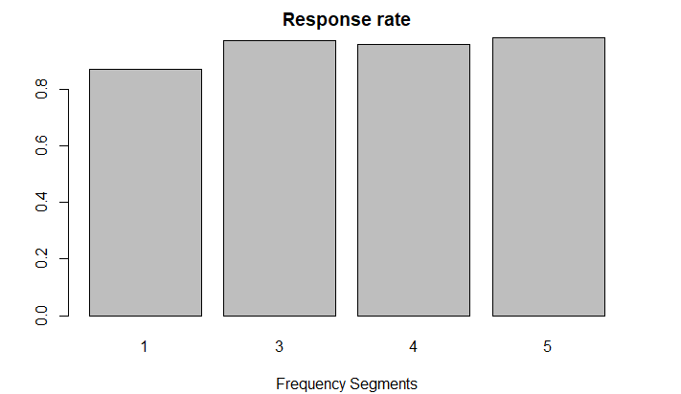
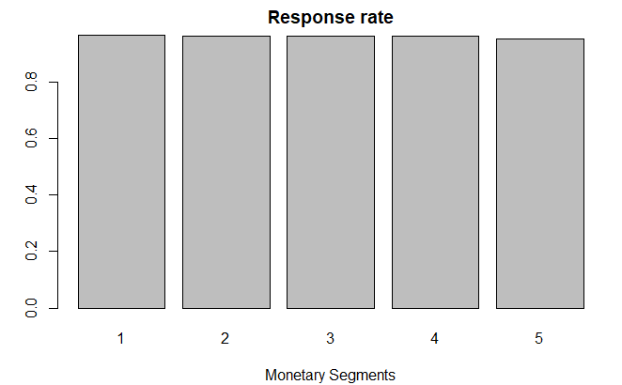
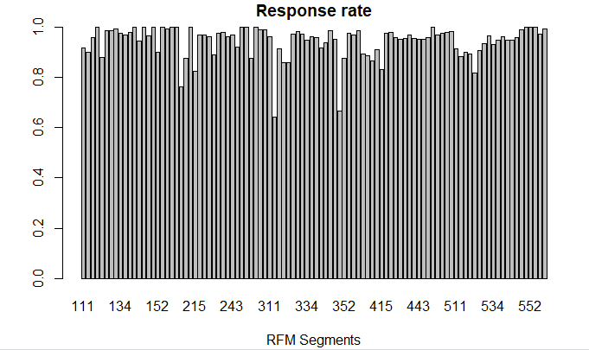
Response Rate for Tasting Rooms
Upon doing the RFM analysis, we discovered that Recency, Frequency, and Monetary segmentation produces approximately the same results across all identified segments.
Thus, looking at email/newsletter/winemaker subscriptions is the next viable option.
Notes:
For tasting room, since there is no subscription needed we took weather a customer bought wine through this channel as a response rate and this is what we got.
The response rate for each segment was close to 1 and this is because our data set contains data of people who are already our customer and since this is the only channel that does not require a subscription almost all customer bought wine through it at some point.

Slide 23
RFM Future Projects
Breakeven analysis on different wine products or direct marketing efforts
Making an offer to a random sample of customers and calculating the Response Rate per RFM segment.
Calculating a break-even response rate based on costs associated with the product/marketing effort
Select all segments above the break-even response rate and make them the offer.

Slide 24
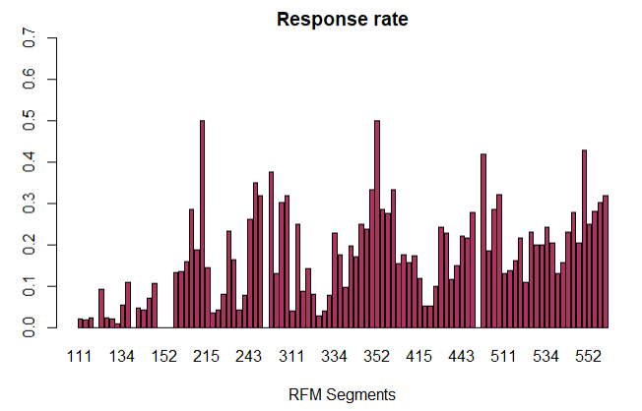
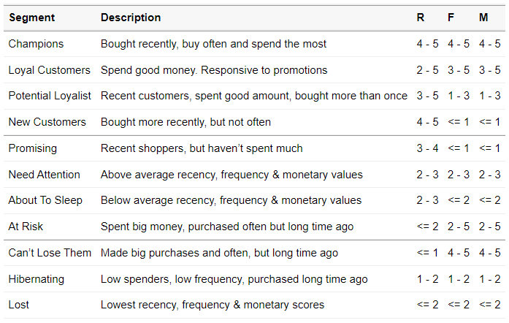
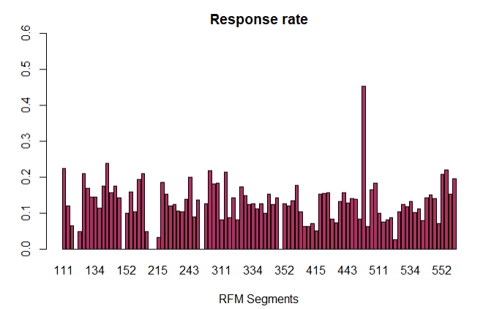
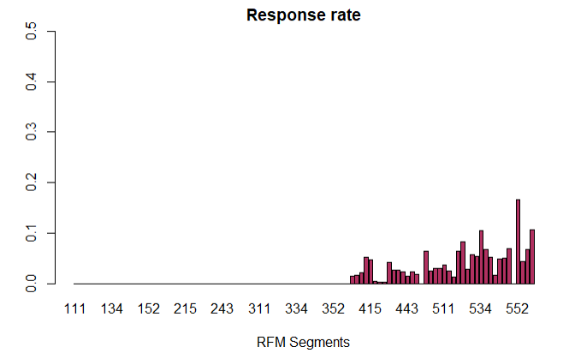
Segment Description
Notes:
And later conduct a regression discontinuity analysis to see if the loyalty program is worth it.
Below we can also see the description of the segments that are the worst and come up with different techniques on how to market to them.

Slide 25




RECOMMENDATIONS
For the segments provided in the data, target them based on purchase rate of each channel and allocate the resources wisely.
Target Segments Differently
With the more granular segmentation, focus on segments 415-555 (the winemaker call subscribers most likely to increase purchases as a result)
Loyalty Program
Include costs of engaging customers in the data in order to calculate LTV for different customer groups
Future Customer Analysis

Slide 26
FUTURE PROJECTS
01
02
03
04
Project 1
Project 2
Project 3
Project 4
How much does it cost to keep a customer engaged via subscription?
How can we retain customers over time?
Advertising Spending for each marketing strategy vs sales
What increases Customer Lifetime Value (CLV)?

Slide 27

THANKS

Slide 28

APPENDIX

Slide 29
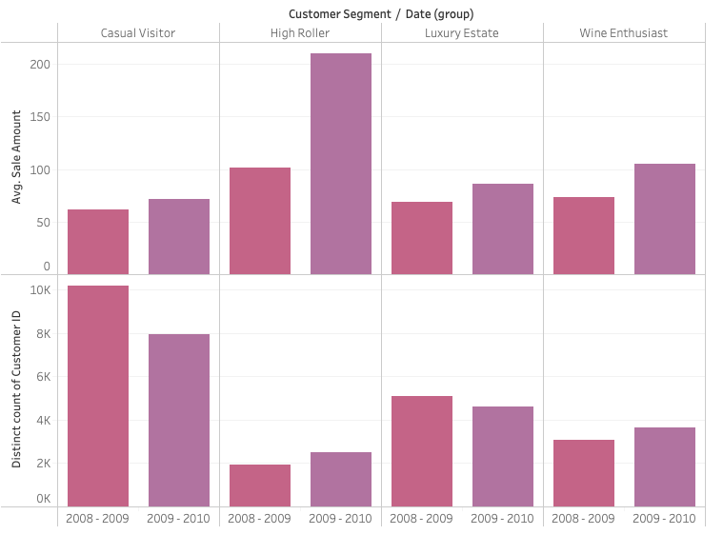
Segment Buying Behavior

Slide 30
RFM Analysis
Number of customers in each segment

